Slide 1
Fixed Income 101
OMAM – risk management
(we can do graphs!)

Slide 2
Time value of money
1£ now is worth more than 1£ tomorrow (if you don’t live in Japan and you are not an institutional investor)
Enter interest rate: price of getting 1£ now instead of tomorrow
Enter interest rate curve: those prices plotted against a time scale

Slide 3
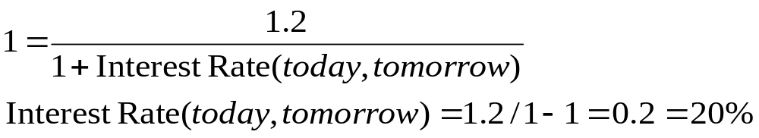
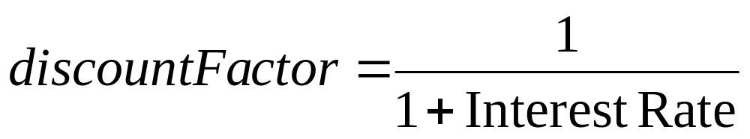
Time Value of money
I’m offered 1.2£ tomorrow by paying 1£ now
The discount factor is what enables us to value how much is worth today some money tomorrow

Slide 4
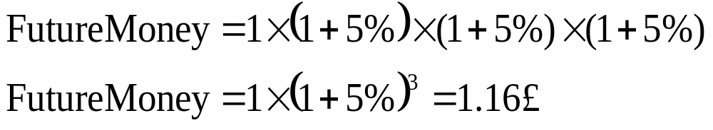
Time Value of money
Periods: years for choice
Interest rates are quoted on per-year basis
Compounding: oh dear, here we go with the heavy math!
  How much I’ll have in 5 years time if I’m leaving my dear 1£ now at 5% interest rate?

Slide 5
One small thing
Price/yield is an inverse relationship!
  If yield goes up, bond prices will go down
  If yield goes down, bond prices will go up
As we will see later on: it’s not a linear relationship!

Slide 6
Lingo
Basis point = 0.01% (or bp in short)
“10 year yield went up 12 basis points” means 10 year interest rates went up 0.12% (e.g. from 4% to 4.12%)
Tics: if someone uses tic instead of bp while talking about interest rates, take out your baseball bat. Tics are for prices (as in “the price moved by 10 tics – from 100 to 100.10”), bps are for yield.

Slide 7
Always forgotten: real interest rate
Are you better off receiving 10% per year on your deposit in a 9% inflation environment or receiving 4% per year in a 2% inflation environment?
Your 10% tomorrow will by 9% less of stuff while your 4% will afford just a 2% less
Give me that 4%!

Slide 8
Bond
Collection of future payments in exchange of some payment right now
Payment right now is (should be) equal to the present value of all those futures payments
Futures payments: principal & coupons
Notional amount = principal
Coupon quoted on an annual basis but it might be paid with a different frequency (semi annual, quarterly)
Coupon can be fixed (e.g. 5%) or floating (Libor + spread)

Slide 9
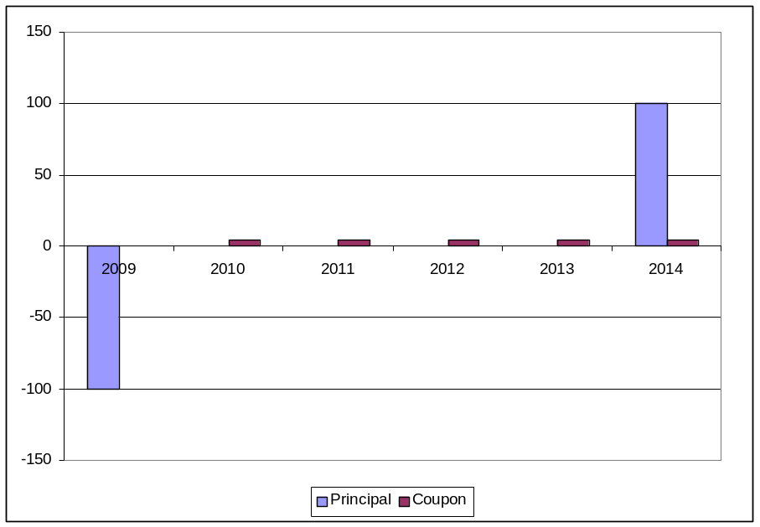
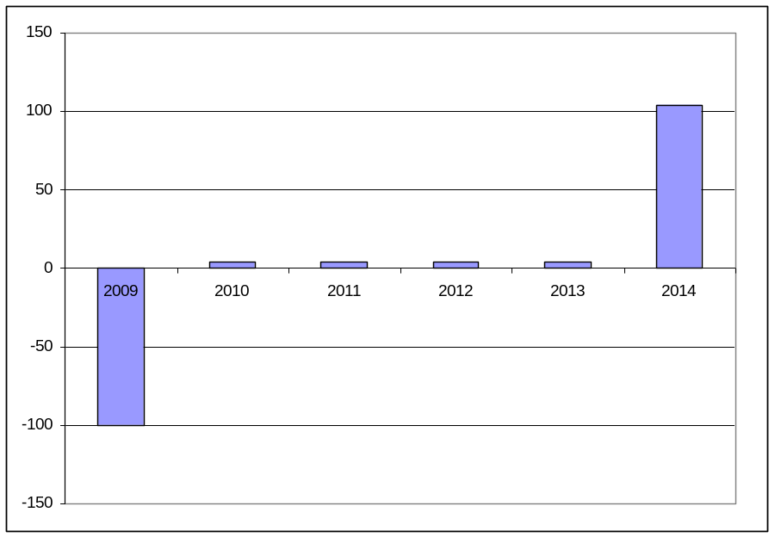
Bond Value: bond flows

Slide 10
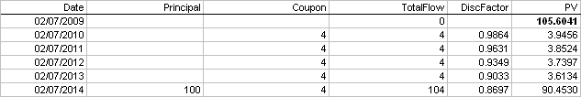
Bond Value: how much is that worth?
Take each future flow and calculate their present value
Sum that up: is it higher than market price? Buy it!

Slide 11
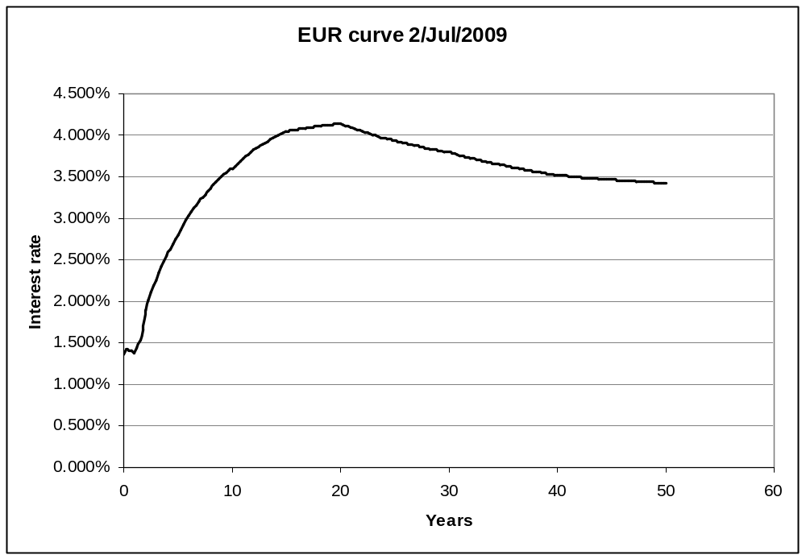
Yield curve example

Slide 12
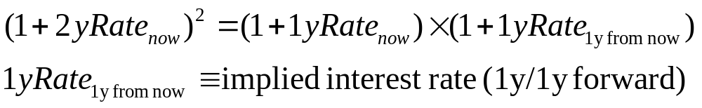
Yield curve siblings
Zero coupon curve: interest rates are quoted for futures values without interim payments
Par curve: interest rates are quoted for assets with interim payments with price of par (100% of nominal value)
Discount factors curve: you get by plotting all the values “now” of £1 in all the futures dates you are interested in. It will be a negative sloped curve!
Forward curves: I’ll spare you the gory details of these … but, the whole things boils down to calculating the implicit interest rate that makes you equally happy by buying a promise of being paid x in 2 years time or by buying a promise of being paid y in one year time and invest that y one year from now for an other year.

Slide 13
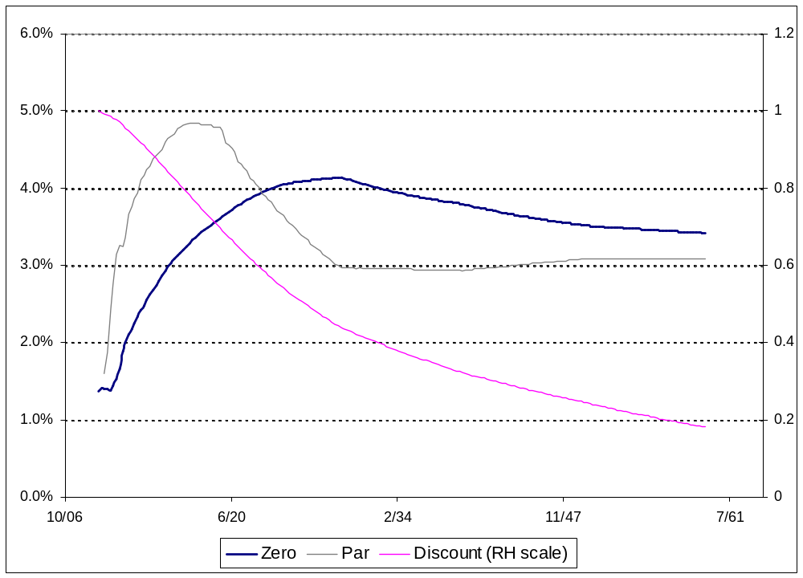
Yield curve siblings: an example (EUR as of 2-Jul)

Slide 14
Spread: how much do you trust me?
Is the price of £1 tomorrow the same for some wealthy sound individual (firm) and some bloke that took a sub-prime mortgage of £2mn on a funny real estate development while earning £10k per year?
I should have used USD actually …
The answer (ask your banker) is: “no” (unless you live in 2006 USA maybe).

Slide 15
Spread: how much do you trust me?
The discount factor for a low trusted entity will be lower (i.e. the interest rate higher) than the one with very good credit credentials.
US Treasury will pay less than Ford co. (should it?)

Slide 16
Spread
The amount of trust awarded to an issuer is expressed by the spread it has to pay over some base rate (libor, treasury)
And then you have the rating agencies …

Slide 17
Duration
Brace yourself: this is a tough one.
What about getting an idea of how long (in years as an example) it takes, on average, you are getting your (PV-ed) future flows?
That measure is called duration

Slide 18
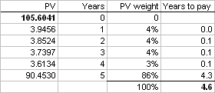
Duration: example
Example: you receive 4% every year for 5 years and 100 at the 5th year.
Example: you receive nothing every year for 5 years and 100 at the 5th year.
  This is an easy one!
  (hint: the average of just one thing is …)

Slide 19
Duration as a measure of risk
Intuition might tell you that a bond with a higher duration is riskier than one with a low duration: if you have to wait more to get your money more nasty things might happen to what you have been promised
Intuition is right: the highest the duration the more sensible (in percentage terms!) is the price of your interest bearing asset to changes in the underlying interest rate (the thing used to get the PV thing)

Slide 20
Duration and its friends
What we defined is called Macaulay duration from a folk called Frederick Macaulay (1882-1970, Canada)
When you have interim payments (i.e. n payments per year) the Macaulay formula has to be adjusted and you’ll have the so called modified duration
If there is some optionality involved in your interest bearing asset you have to change completely your formula and you’ll have a (numerically computed) effective duration
All of them will tell you how much (IN PERCENTAGE TERM) the price of your stuff will change for a given change of the interest rates

Slide 21
The not so interesting (but widely used) price value of a basis point
A.K.A. PV01 (as in present value of a bp), DV01 (as in dollar value of a bp)
This will tell you how much (in tics) the price of a bond will move for a movement of the interest rate.
It’s an ABSOLUTE measure of price change (not relative as the duration one).

Slide 22
Duration vs. PV01
 | UKT 5% 03/2018 | BTPSR 0% 2/2033
Price (yield) | 111.56 (3.45%) | 26.61 (5.78%)
Mod.Duration | 7.02 | 22.3
PV01 | 7.95 | 5.9
That means (using BTP zero coupon bond): if yield goes up 1bp (5.79% from 5.78%) price will go down to 26.55 (or by 22.3%)

Slide 23
Small letters …
Problem with all that is: this is all a (quite good) approximation for small changes in yield
Relationship between yield and price is not linear!
Using Duration or PV01 we are just using a linear approximation to the “good relationship”
The amount of our error is called convexity

Slide 24
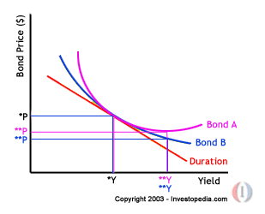
Convexity
Convexity is affected by the amount of interim payments (the higher they are the higher the convexity
  Zero coupon bonds have zero convexity!
High convexity is a good thing: it’s like having an embedded option!

Slide 25
More lingo …
Curve parallel move: it happens (it never happens actually) when the whole curve moves up or down by a certain amount of basis points
Curve twist: curve might steepen (i.e. short terms rates gets lower vs. long term rates) or flatten (i.e. short term rates gets higher vs. long term rates).
If someone tells “I have a steepener on” he just means he bought short term paper and sold long term paper and will (hopefully) takes advantage of relative moves in the yield curve where short term paper appreciate more (proportionally: where the proportion is calculated using the risk valued we talked about before) than the long term one. The opposite goes if he has a “flattener”

Slide 26
More lingo …
Curve shape: you can have convex yield curves (typically when you have expectations of higher interest rates in the futures) and concave yield curves
Strategies based on the curve shape (called barbells) will try to take advantage of changes in that shape by buying/selling the mid part of the curve (e.g. 5y bonds) and selling a proportional amount of the extremes of the yield curve (e.g. 2y and 10y bonds)

Slide 27
Yields up/down: where, what?
We are saying “yield goes up, yield goes down” but we said before we have an entire yield curve as a “summary” of the interest rate world (for each currency, for each issuer!)
What we like to do is to measure bond price sensitivity (risk) on moves of specific points of the curve
We call those specific points Key Rate and the risk each portfolio place on those points will be called Key Rate Durations

Slide 28
Key Rate Duration
Key rate duration table for a portfolio playing a steepening strategy
If 2y yield goes down 2bp and 10y yield goes down 1bp (or 2y up 1bp and 10y up 2bp) he will roughly make 10x0.01%xSize
KR | Duration
2 | 10
5 | 0
10 | -10

